Slide 1
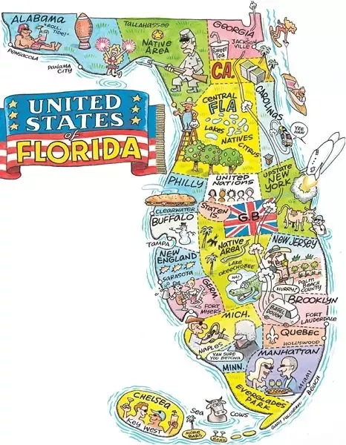
What is Florida’s Future? And can we influence it?
Lawrence Fisher
http://www.tampabay.com/news/perspective/
perspective-how-much-land-to-protect/2226788

Slide 2
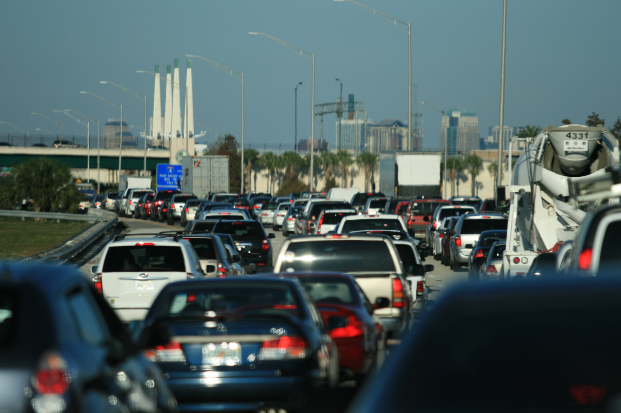
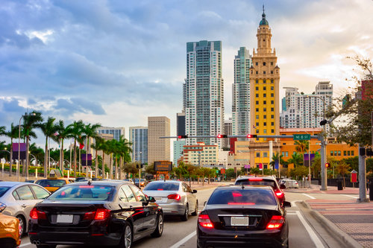
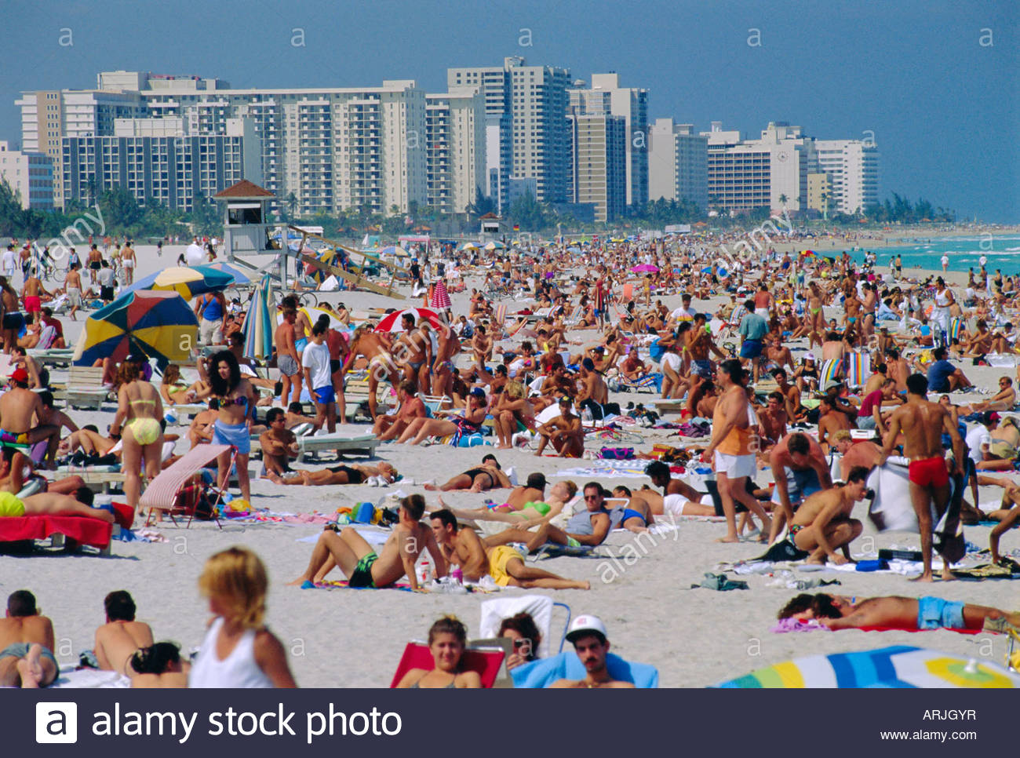
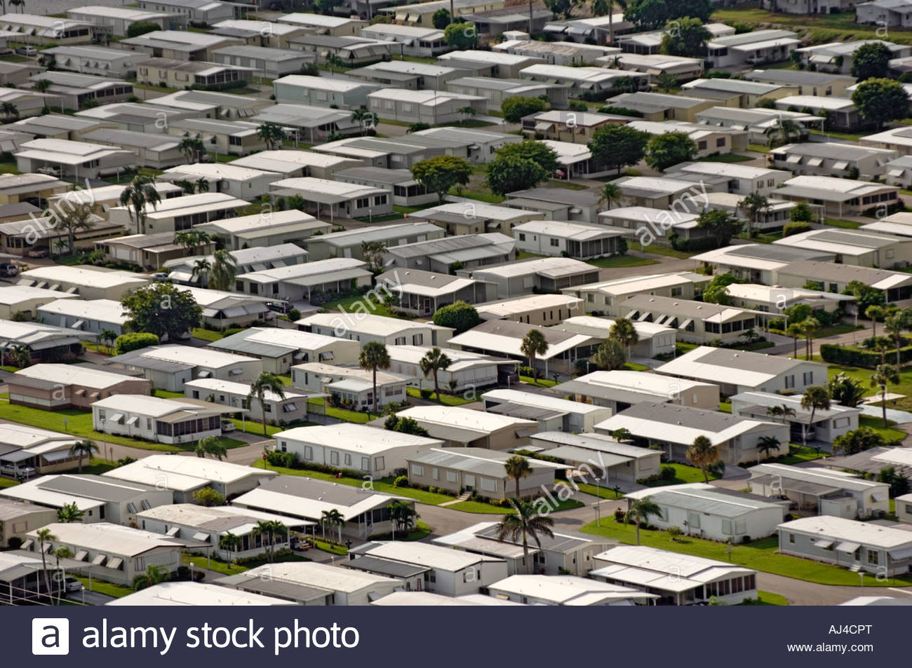

Slide 3
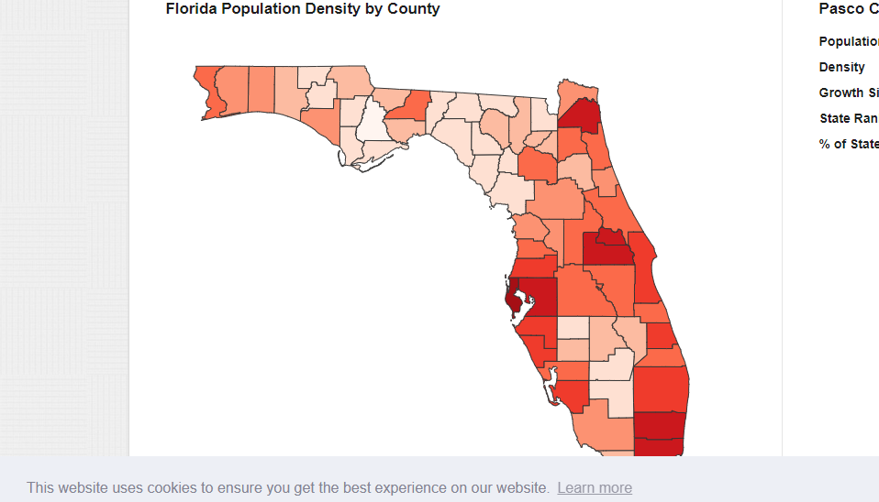
More than 300,000 people move here each year!
How Many People Live
in Florida?
21,312,211
We are #3 in the USA and one of the most densely populated (#8)
Based on moderate projections by the Florida
Bureau of Economic and Business Research (BEBR),
Florida’s population is projected to grow to
approximately 33.7 million residents by 2070,
14.9 million more people than in 2010.

Slide 4
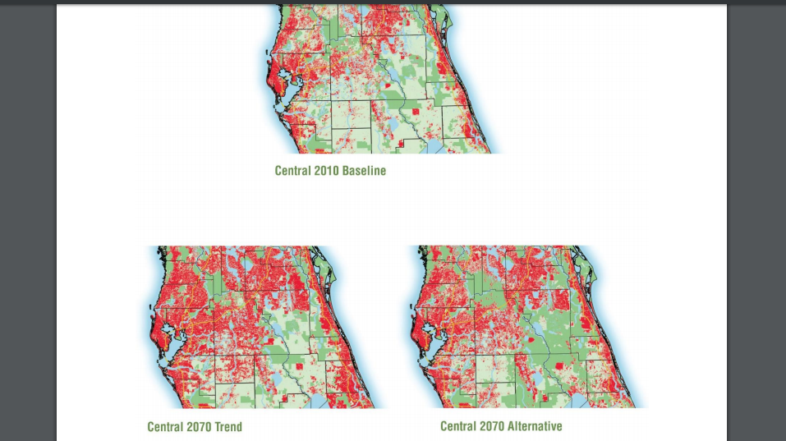
Now and Then – 2010 and 2070

Slide 5
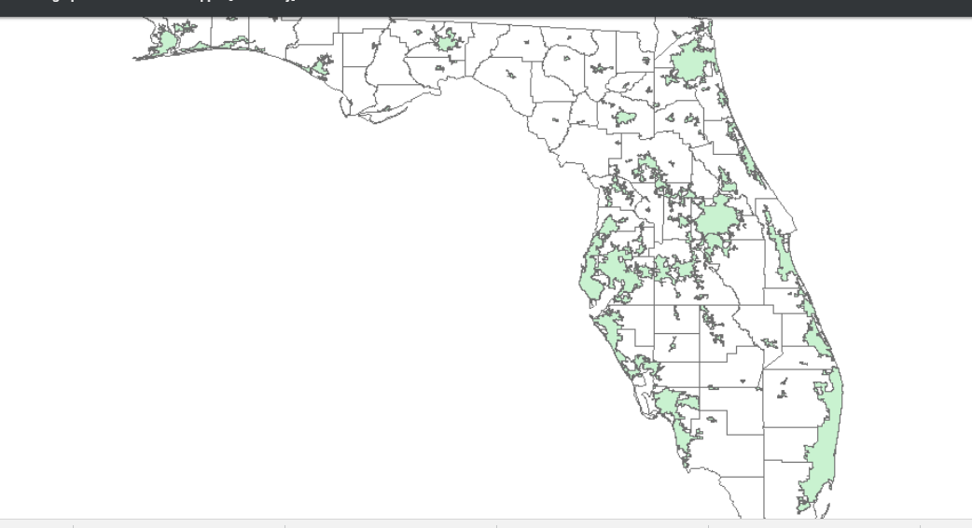
How do you think these urban areas will look in 50 years? Shade in your map!
Florida’s Urban Areas

Slide 6
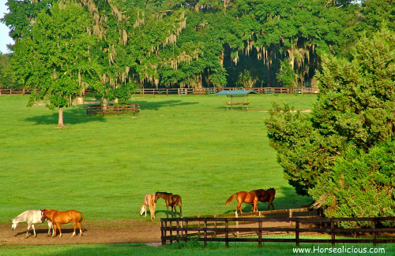
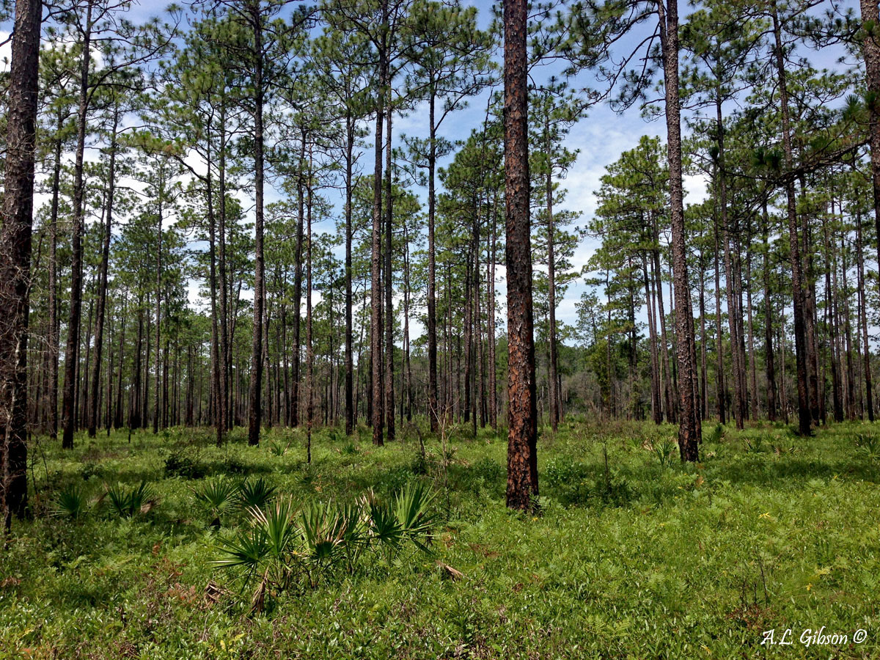
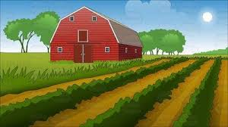
What should we save and protect?

Slide 7
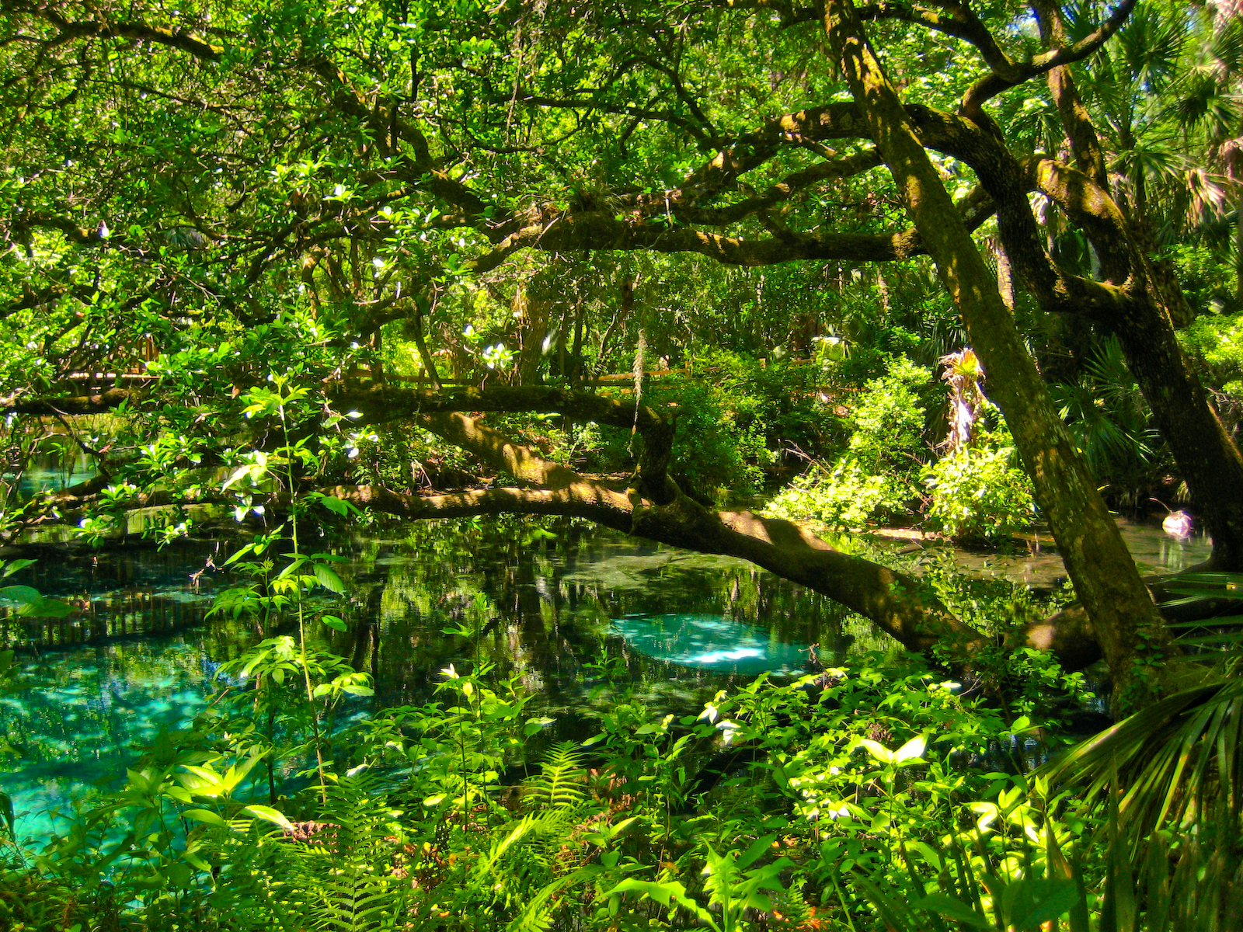

Slide 8
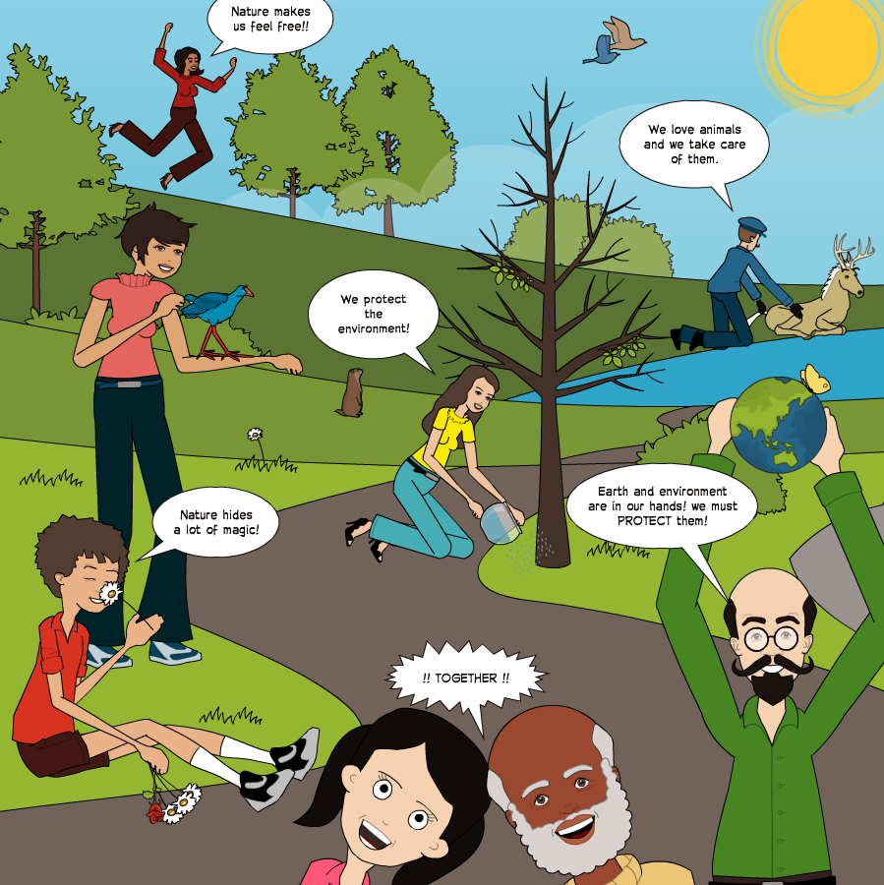
…And who decides?
People who care
the most.

Slide 9
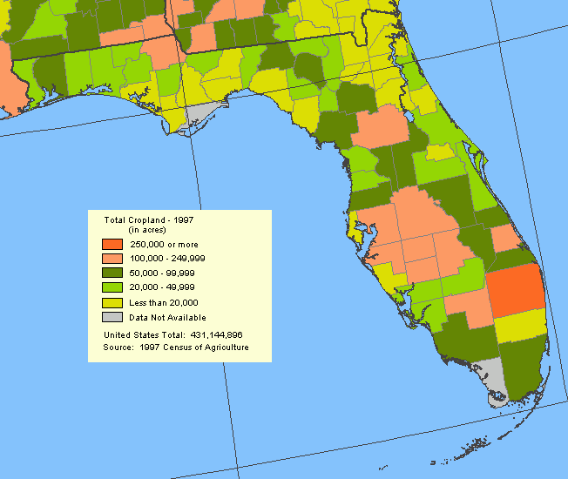
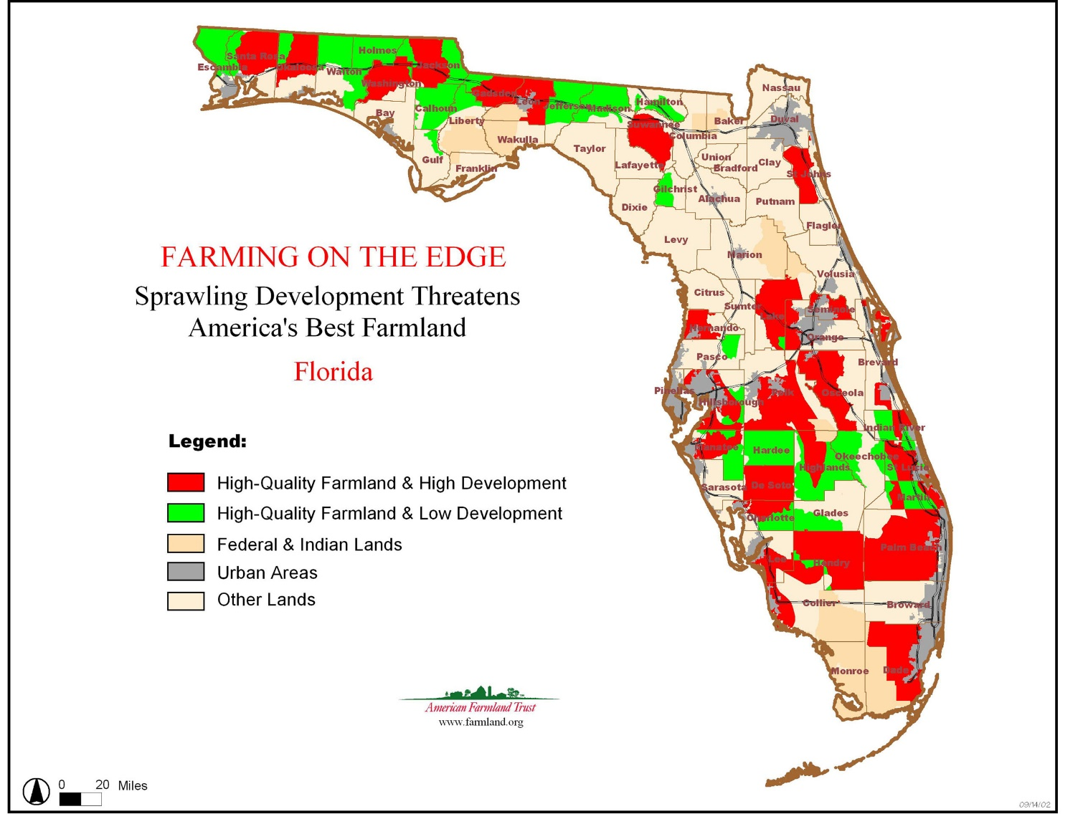
Total Farmland
At Risk Farmland
Farmers and Ranchers care, too!

Slide 10
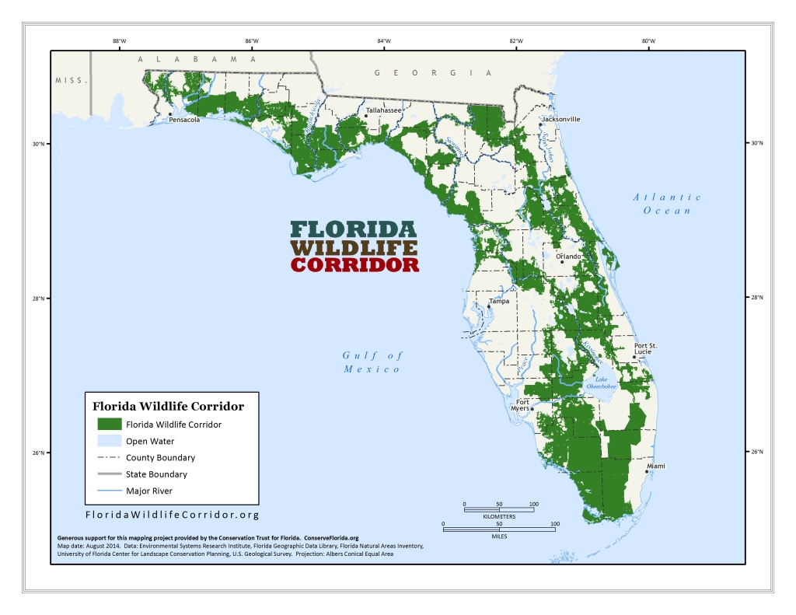
Conservationists and people who like nature care, too!

Slide 11
Developed Lands
Conservation Lands
Farmland

Slide 12
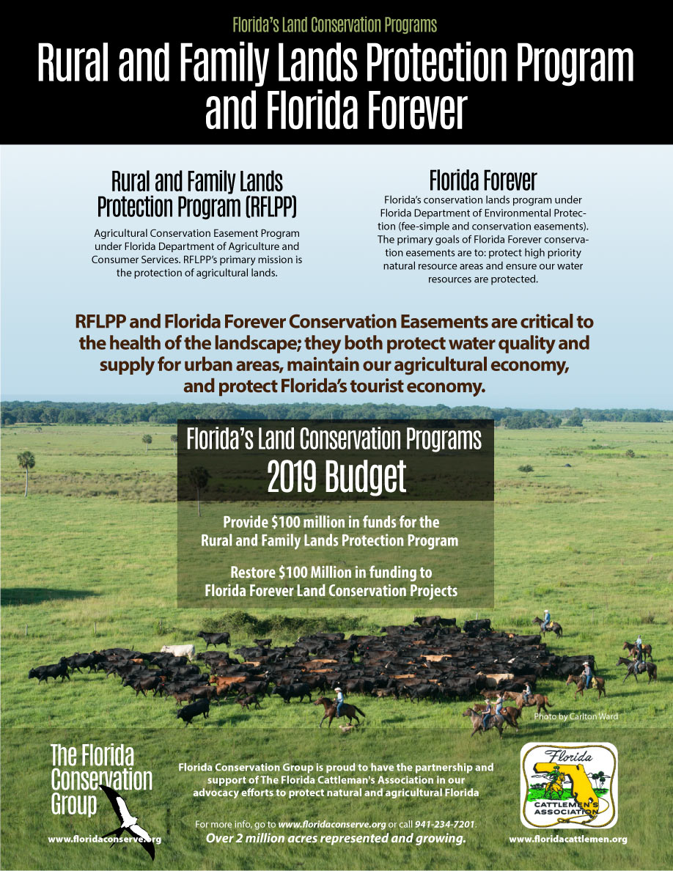
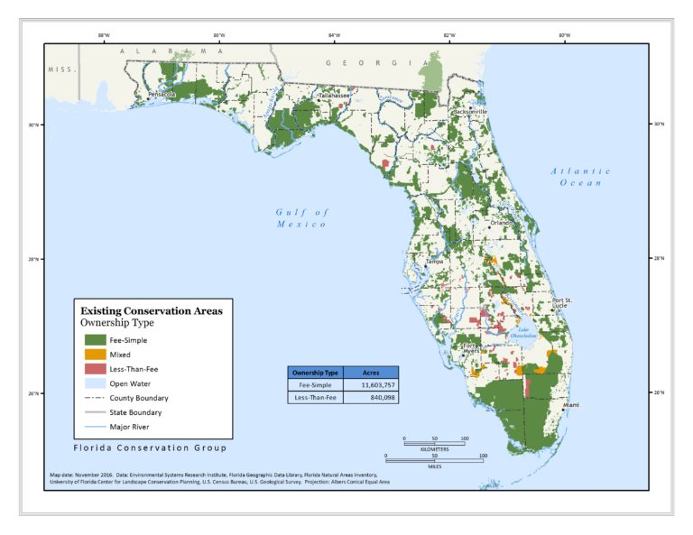

Slide 13
Fancy three slide overlay in progress!

