Slide 1


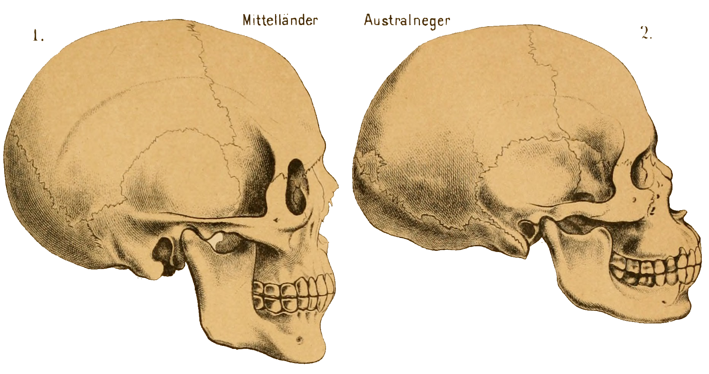
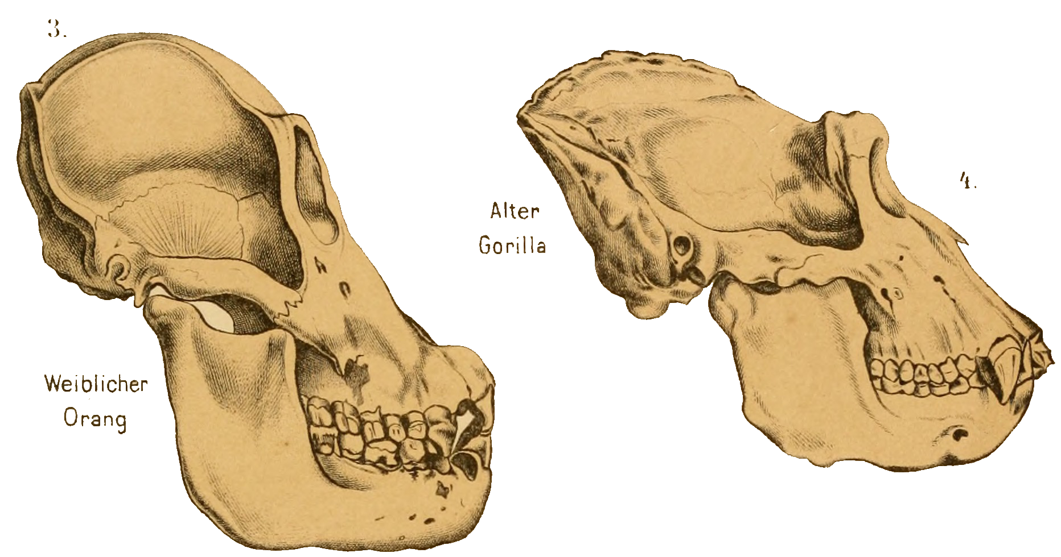
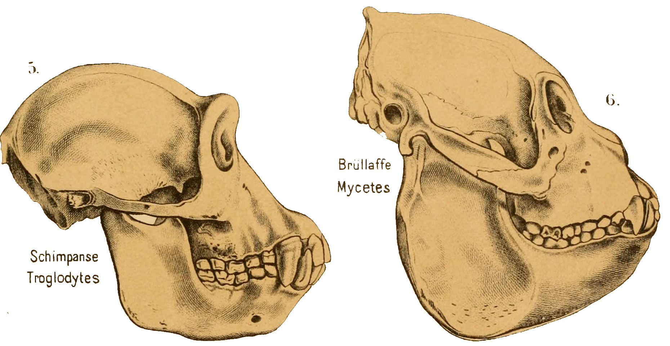
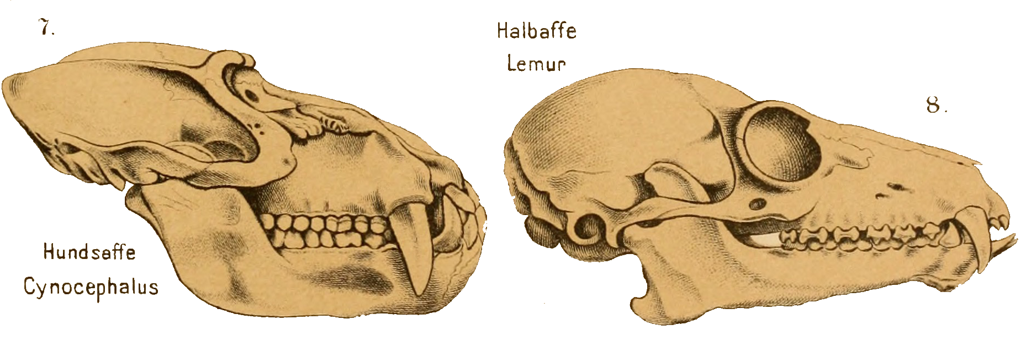
Hands-on Human Evolution

Slide 2
What similarities in answers do we see?
What organisms evolve?

Slide 3
What is Evolution?
Evolution is the descent of an organism with modification that happen over a large time period

Slide 4
True or False
Humans are still evolving
Humans are not primates
Humans evolved directly from chimpanzees
Humans have a larger cranial capacity than a gorilla
Humans and Neanderthals are the same species

Slide 5
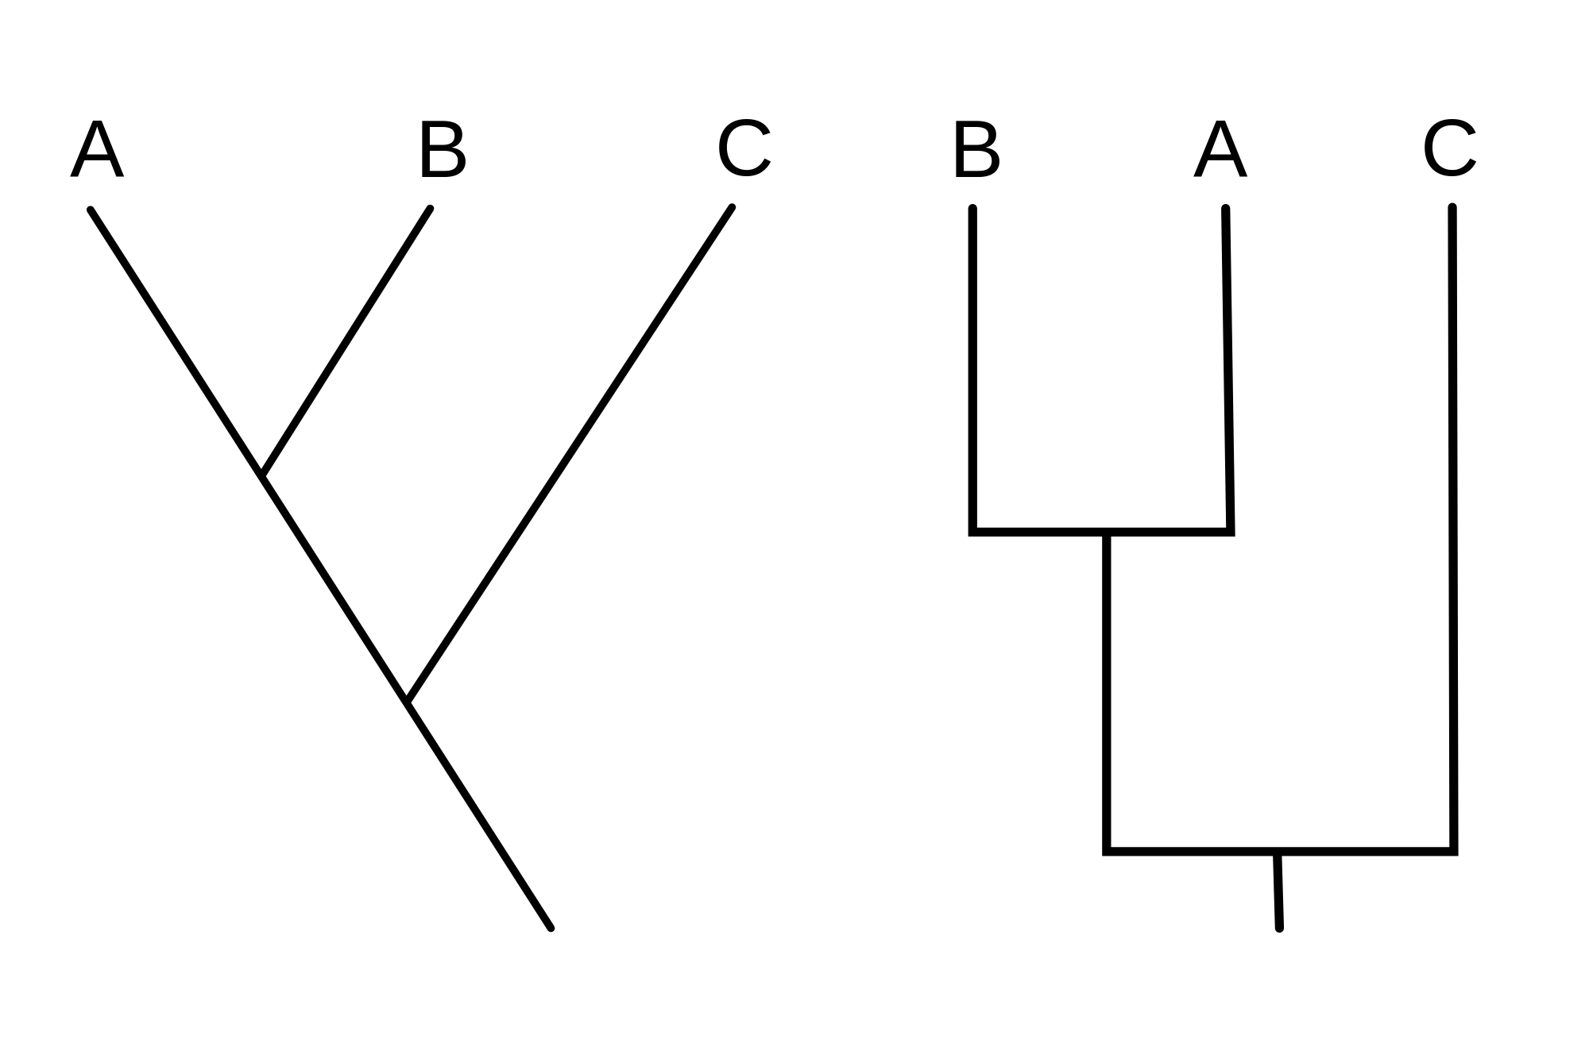
Understanding Cladistics
Cladistics is a method of classifying organisms by shared derived characteristics
Clade
Derived Trait
Common Ancestor
Notes:
Images: https://en.wikipedia.org/wiki/Cladogram

Slide 6
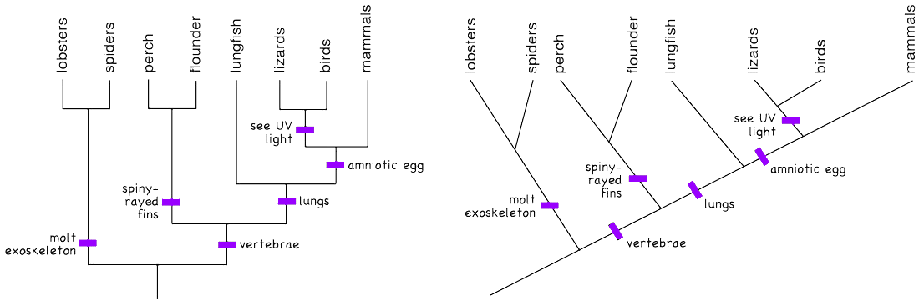
Cladogram example
Can you tell which organisms make up a single clade?
Notes:
Images: https://cladogramed6228.weebly.com/examples-of-cladograms.html

Slide 7
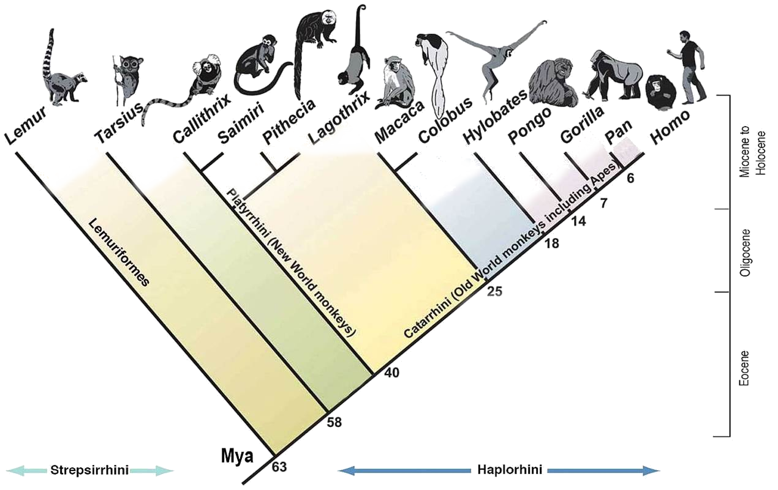
Misconceptions about Human Evolution

Slide 8
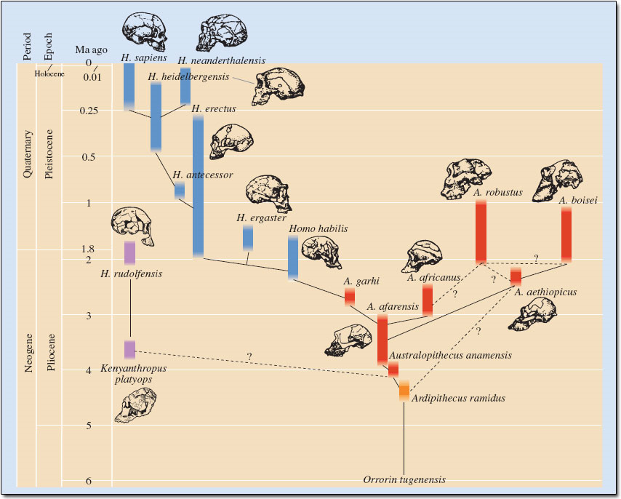

Slide 9
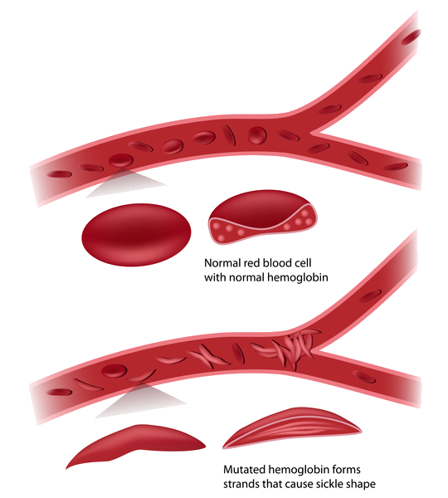
Are Humans Still Evolving?
Let’s take a look at Sickle Cell Anemia
Sickle Cell Anemia is a genetic mutation that causes the cells the form and create a sickle (crescent) shape.
Issues present with this mutation
  Cells can get caught and block pathways
  Clots are extremely dangerous
  Delay of growth in infants, children, and teenagers
  Damage to organs due to lack of oxygen
Benefits of this mutation
  Protection against Malaria
Those who live in Malaria prevelent regions, tends to have sickle cell as a natural defense against the infection
Notes:
Images: https://ghr.nlm.nih.gov/condition/sickle-cell-disease

Slide 10
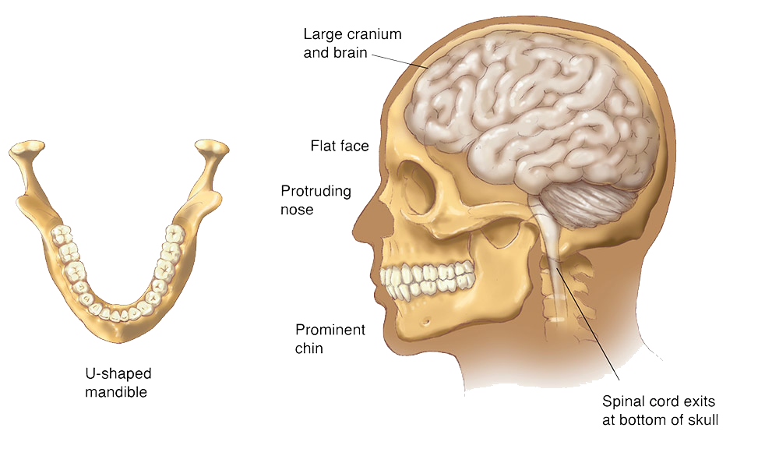
Human VS. Gorilla
What features are extremely different? Which are similar?
Notes:
Images:https://www.carlsonstockart.com/gallery/evolution-and-genetics/

Slide 11
Important Cranium Terminology
Foramen Magnum - Hole at the base of the skull where the where the spinal cord exits
Zygomatic Arches - Cheek bones that extend from the side of the skull
Brow Ridge - Bony ridge located above the eye sockets
Nuchal Crest - A bony ridge that runs laterally around the back of the skull centered on the externa

Slide 12
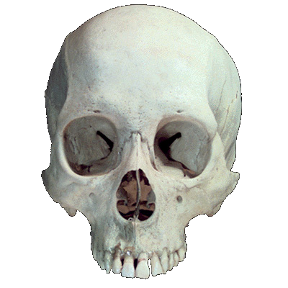
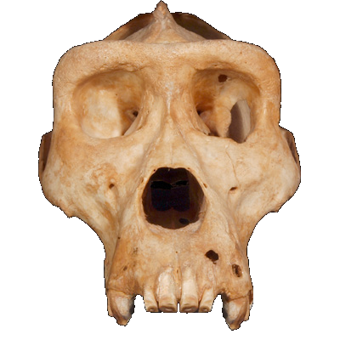
Gorilla VS Human Skull
Sagittal Crest
Brow Ridge
Zygomatic
Arch
Notes:
Images: http://eskeletons.org/compant

Slide 13
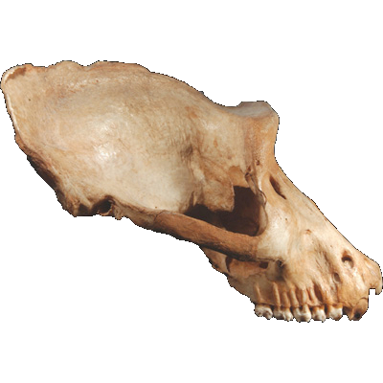
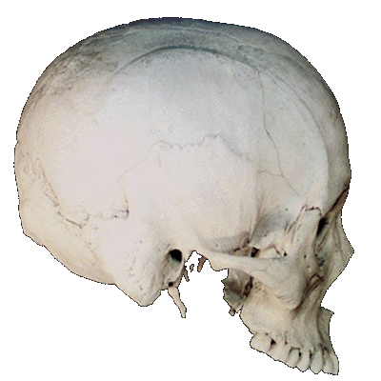
Gorilla VS Human Skull
Sagittal Crest
Brow Ridge
Nuchal Crest
Zygomatic
Arch
Zygomatic
Arch
Notes:
Images: http://eskeletons.org/compant

Slide 14
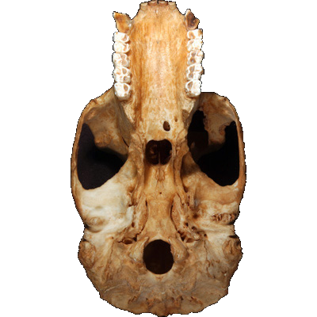
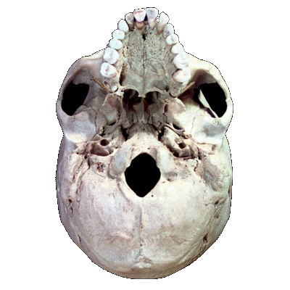
Take a look at the upper mandible, is there anything that you notice? Keep a look out for the upper mandible when checking out the skulls!
Foramen
Magnum
Notes:
Images: http://eskeletons.org/compant

Slide 15
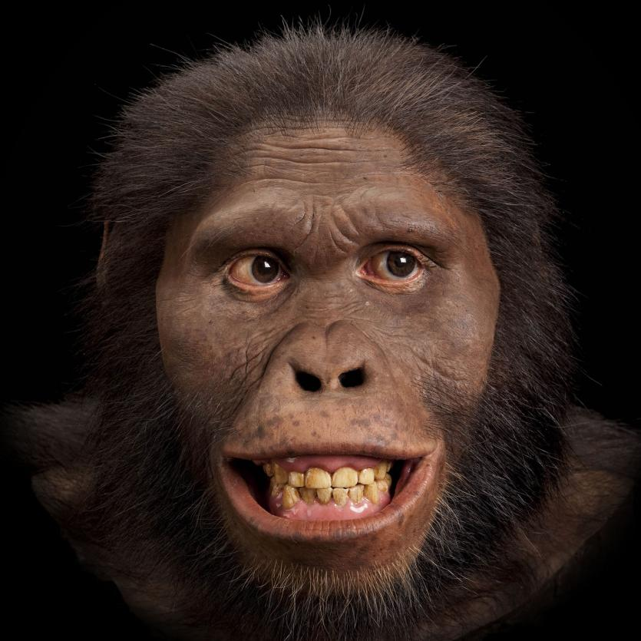
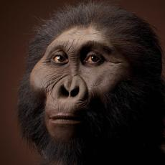
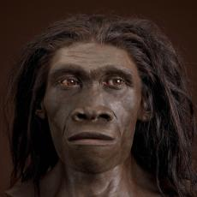
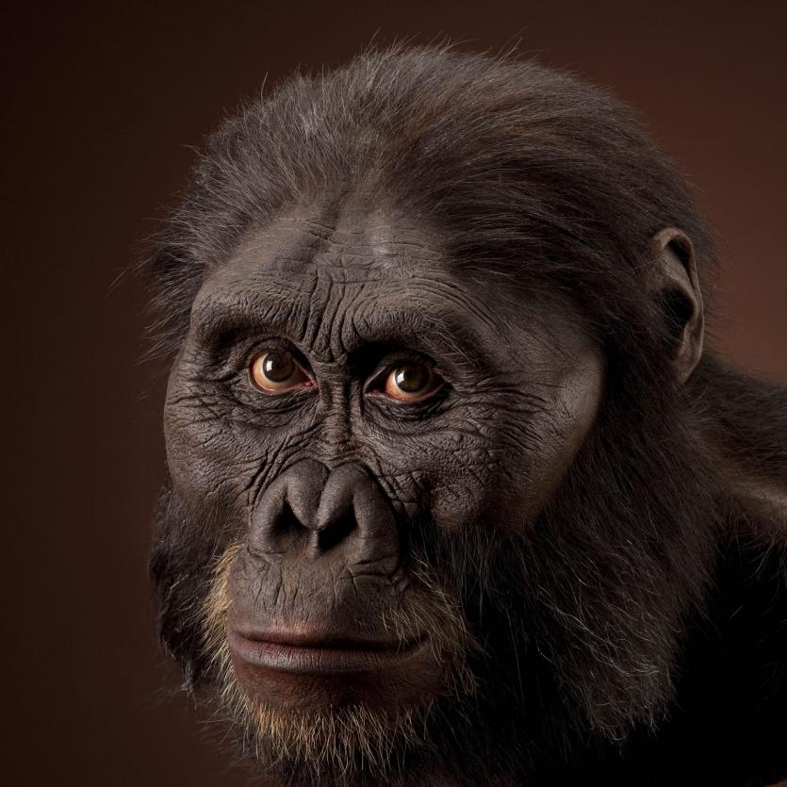
Meet the Skulls!
Australopithecus afarensis
“Lucy”
Homo erectus
Australopithecus africanus
Paranthropus boisei
(Australopitecus boisei)
Notes:
Images : http://humanorigins.si.edu/evidence/human-fossils/species

Slide 16
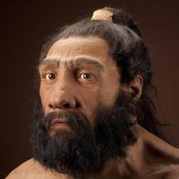
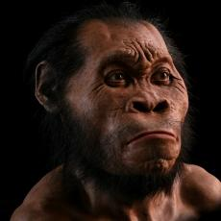
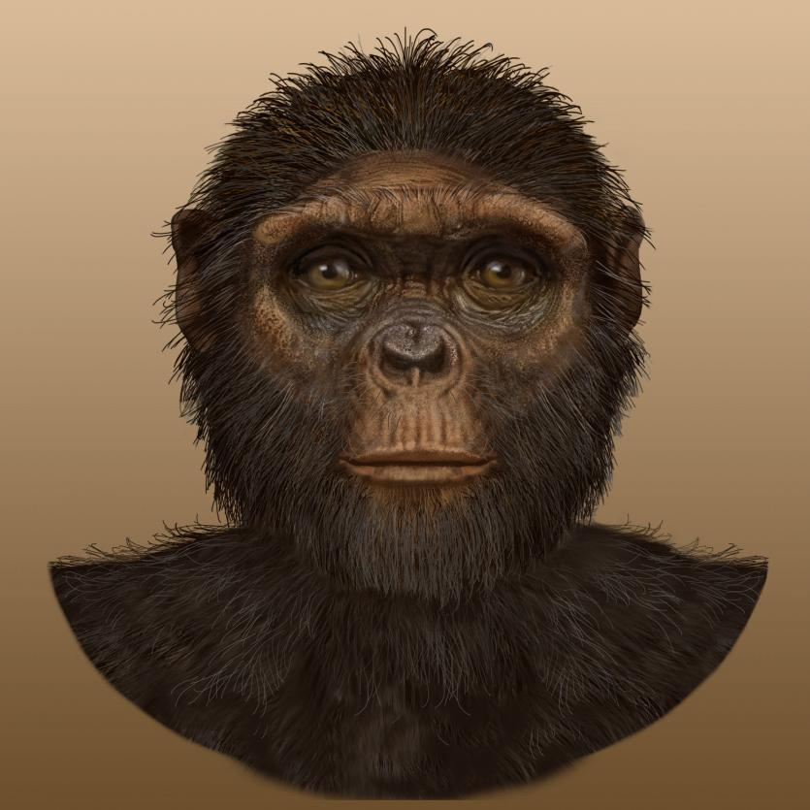
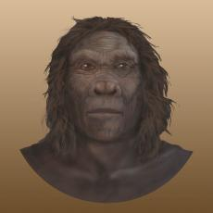
Meet the Skulls!
Ardipithecus ramidus
“Ardi”
Homo habilis
Homo neanderthalesis
Homo naledi
“Neo”
Notes:
Images: http://humanorigins.si.edu/evidence/human-fossils/species

Slide 17
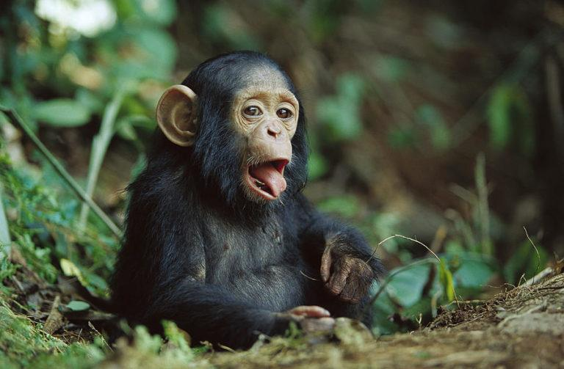
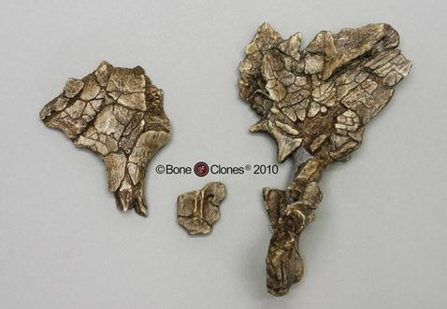
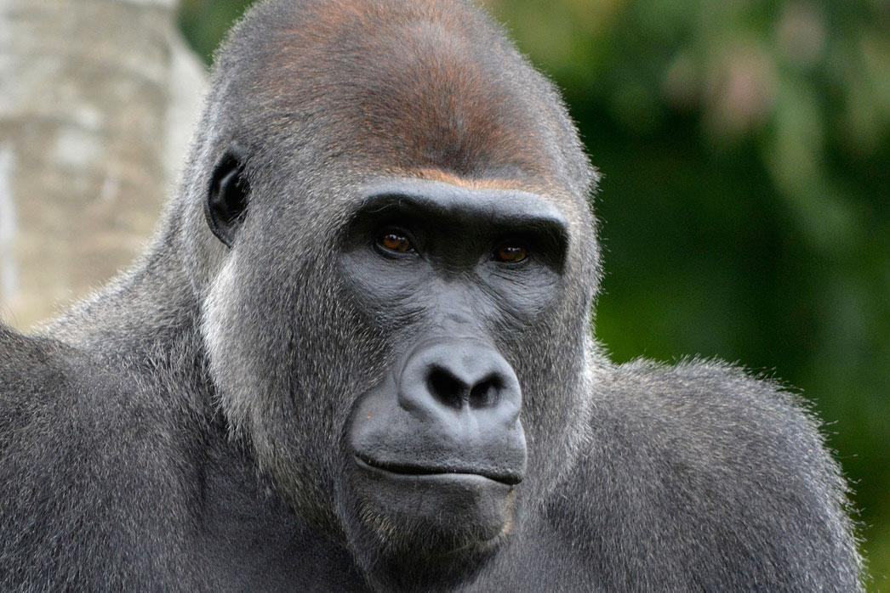
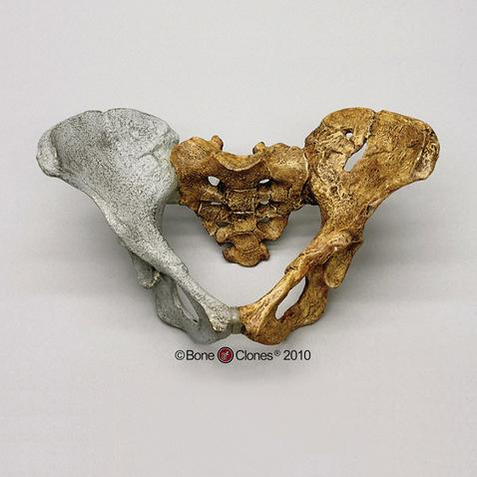
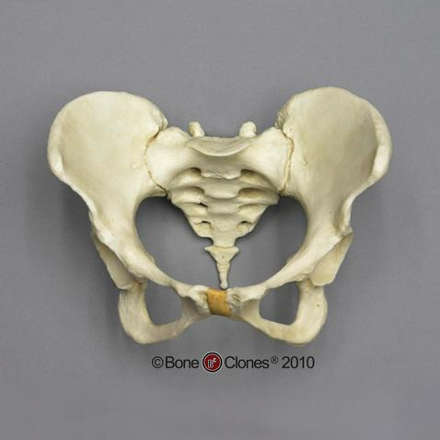
What about the other bones?
As you are going throughout the stations you will see:
Chimpanzee Skull
A. Africanus Pelvis
Gorilla Skull
Female Human Pelvis
A. Afarensis Pelvis
Notes:
Chimpanzee : https://www.earth.com/animals/chimpanzee-pan-troglodytes/
Gorilla : https://detroitzoo.org/animals/zoo-animals/gorilla-western-lowland/
Pelvis :

Slide 18
Lesson 1
Hominid Evolution Evidence Stations

Slide 19
What you will be doing today
Familiarizing yourself with species closely related to Homo sapiens
Exploring morphological features of several hominids and hominins
Determining what trends are evident from these casts
Looking at relatedness of extant species using both morphological and genetic data

Slide 20
Time to find Cranial Capacity!
The cranial capacity is the cubic (mL = cm³) capacity that helps estimate the volume of space a brain would take up
Station 1 | Cranial Capacity in the genus Homo Part 1
Station 2 | Cranial Capacity in the genus Homo Part 2
Station 3 | Bipedalism
Station 4 | Apes and Humans
Station 5 | Cranial Capacity in the Australopithecines
Station 6 | Investigating differences between Homo and Australopithecus
Station 7 | Ardipithecus ramidus

Slide 21
What do you think H. Sapiens will look like in 1,000 years?

Slide 22
Lesson 2
Molecular Evidence

Slide 23
True or False
The casts that we examined demonstrated a common ancestry between us and our hominid ancestors.
The bones, which the casts are made from, look the way they do because of genes and DNA.
Molecular data, like DNA, can also show how organisms are related.
Amino acids, the building blocks of proteins, can also show how organisms are related.
Scientists only use one piece of evidence to reach a conclusion on a question

Slide 24
What is a phylogeny?
Phylogenetics is the study of genetic relationships between organisms
Scientist use nucleotide or protein sequences to compare species

Slide 25
Vocabulary to Know
Amino Acids - The building blocks of proteins
Gene sequence - The precise order of nucleotides within a DNA molecule
Base Pairs- Nitrogenous bases that pair up to connect the complementary strands of DNA
Inversion - When part of a chromosome breaks loose and reassembles, but in the backwards orientation
Chromosome - Packaged and threadlike structure that contains an organism’s nuclear DNA
Protein Coding DNA Sequence - A particular order of nucleotides within a DNA molecule that code for a specific protein
Deletion - When errors in DNA replication (or meiosis) cause the permanent loss one or more bases which can result in the loss of part of a chromosome
Pseudogene - A nonfunctional evolutionary remnant of a gene in a species or group of related species
Duplication- When errors in DNA replication cause one or more base pairs of DNA to be repeated

Slide 26
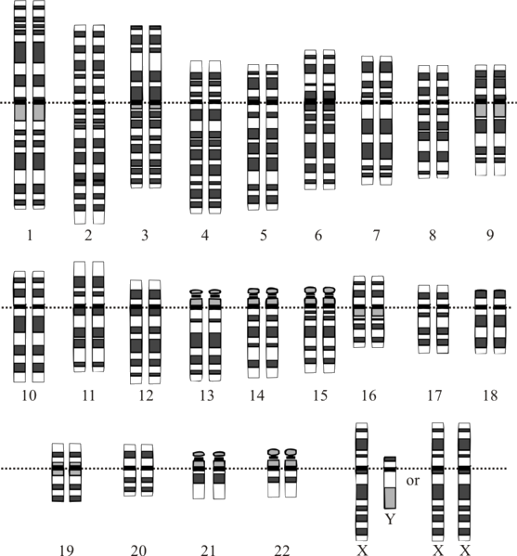
What does a chromosome look like?
Notes:
https://en.wikipedia.org/wiki/Human_genome#/media/File:Karyotype.png

Slide 27
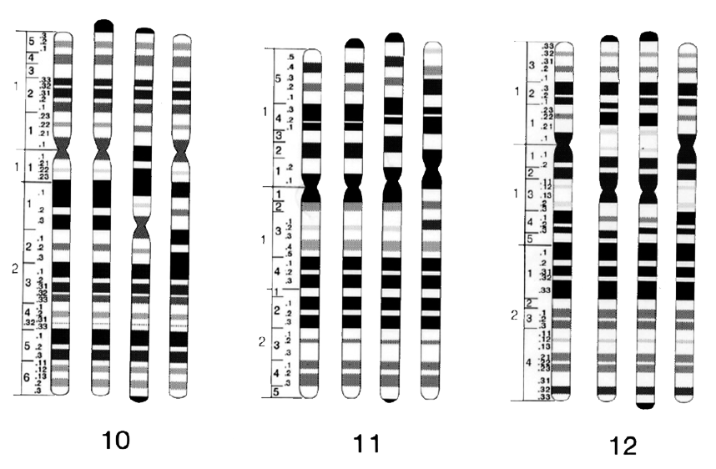
A-T rich regions stain darker
G-C rich regions stain lighter

Slide 28
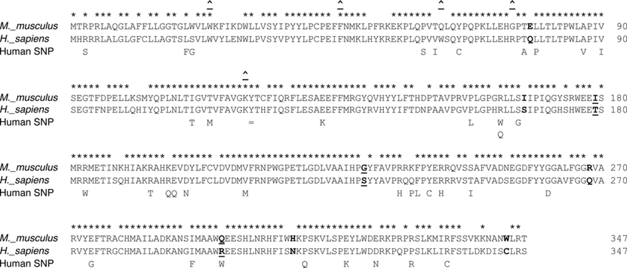
Amino Acids

Slide 29
Lesson 3
Naledi Jigsaw

Slide 30
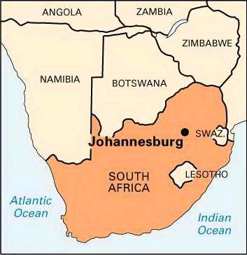
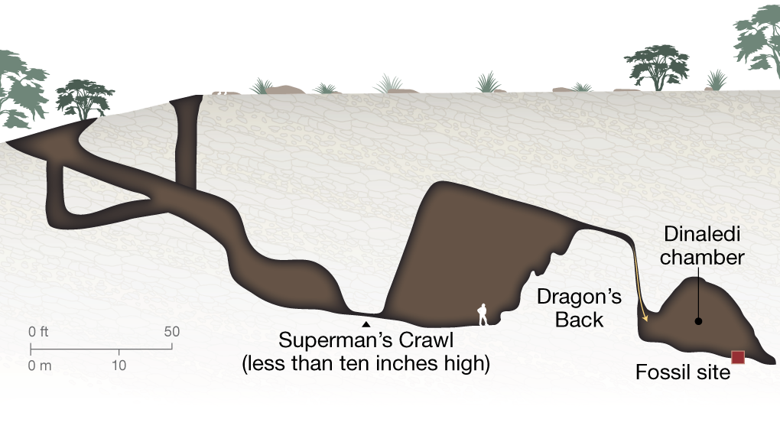
Where does this take place ?
Rising Star

Slide 31
Extension Activity
TV Episode: Townsley, G. (Director). (2015, September 16). Nova [Television series episode]. In Dawn of Humanity. PBS. (Run time: 113 minutes)
Dawn of Humanity | NOVA
Episode Summary:
This episode of Nova retells the scientific discoveries of Homo naledi and Australopithecine sediba by Lee Berger and his team. Students will see first-hand how Berger and his team scientifically investigated his new findings through camera footage from the scientists and the National Geographic camera crew. This episode addresses the nature of science, scientific protocol, human evolution, and basic osteological facts.

