Slide 1
Eocene Epoch (55.8-33.9 Ma)

Slide 2
Oligocene Epoch (33.9-23 Ma)

Slide 3
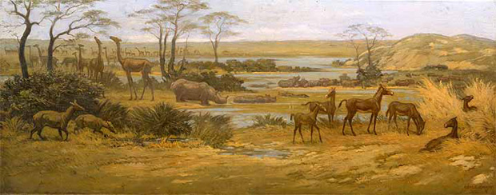
Miocene Epoch (23-5.3 Ma)

Slide 4
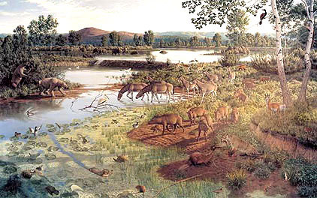
Pliocene Epoch (5.3-2.7 Ma)

Slide 5
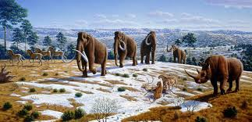
Pleistocene Epoch (2.7-0.01 Ma)

