Slide 1
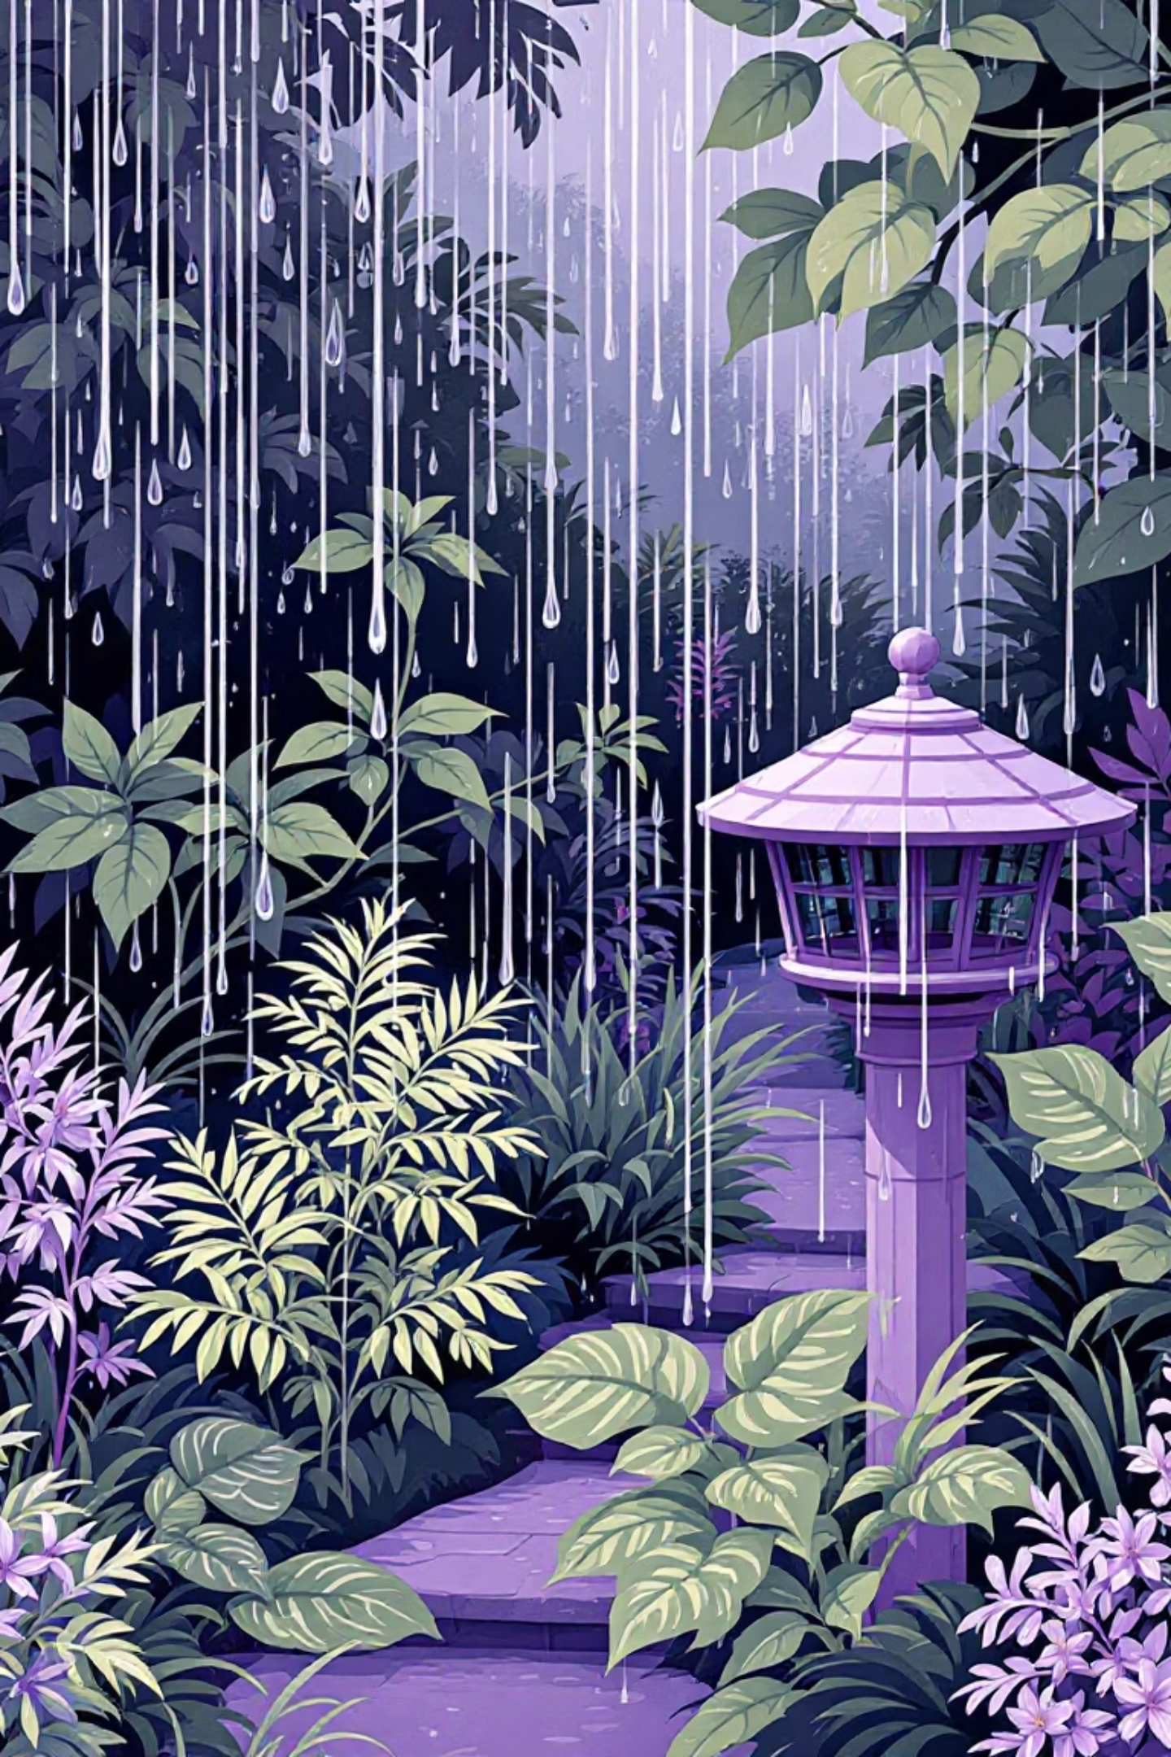
To Water or Not to Water: 5th Grade Environmental Science Lesson
A 60-minute lab investigation helping students understand water-efficient landscaping practices in Florida's unique climate.
Amanda Wink
Fishhawk Creek Elementary
Grade 5

Slide 2



Intended Outcomes & Assessment
LEARN
ACT
ASSESS
Florida's climate impacts on water use
Design water-conserving landscapes
Station activity completion
Landscape design project
Water-efficient landscaping techniques
Suggest conservation strategies at home
Creative exit ticket reflection
Florida-Friendly plant selection
Make informed environmental choices

Slide 3
Learning Objectives & Standards
1
2
3
Learning Objectives
Standards Alignment
Guiding Question
Students will explain how water-efficient landscaping practices support sustainability by conserving water in Florida's climate and relate this to local weather and seasonal rainfall.
SC.4.E.6.6 (Review)
How can we use what we know about Florida's climate to water our landscape in a way that saves water and protects the environment?
SC.4.L.17.4 (Review)
SC.5.E.7.6

Slide 4
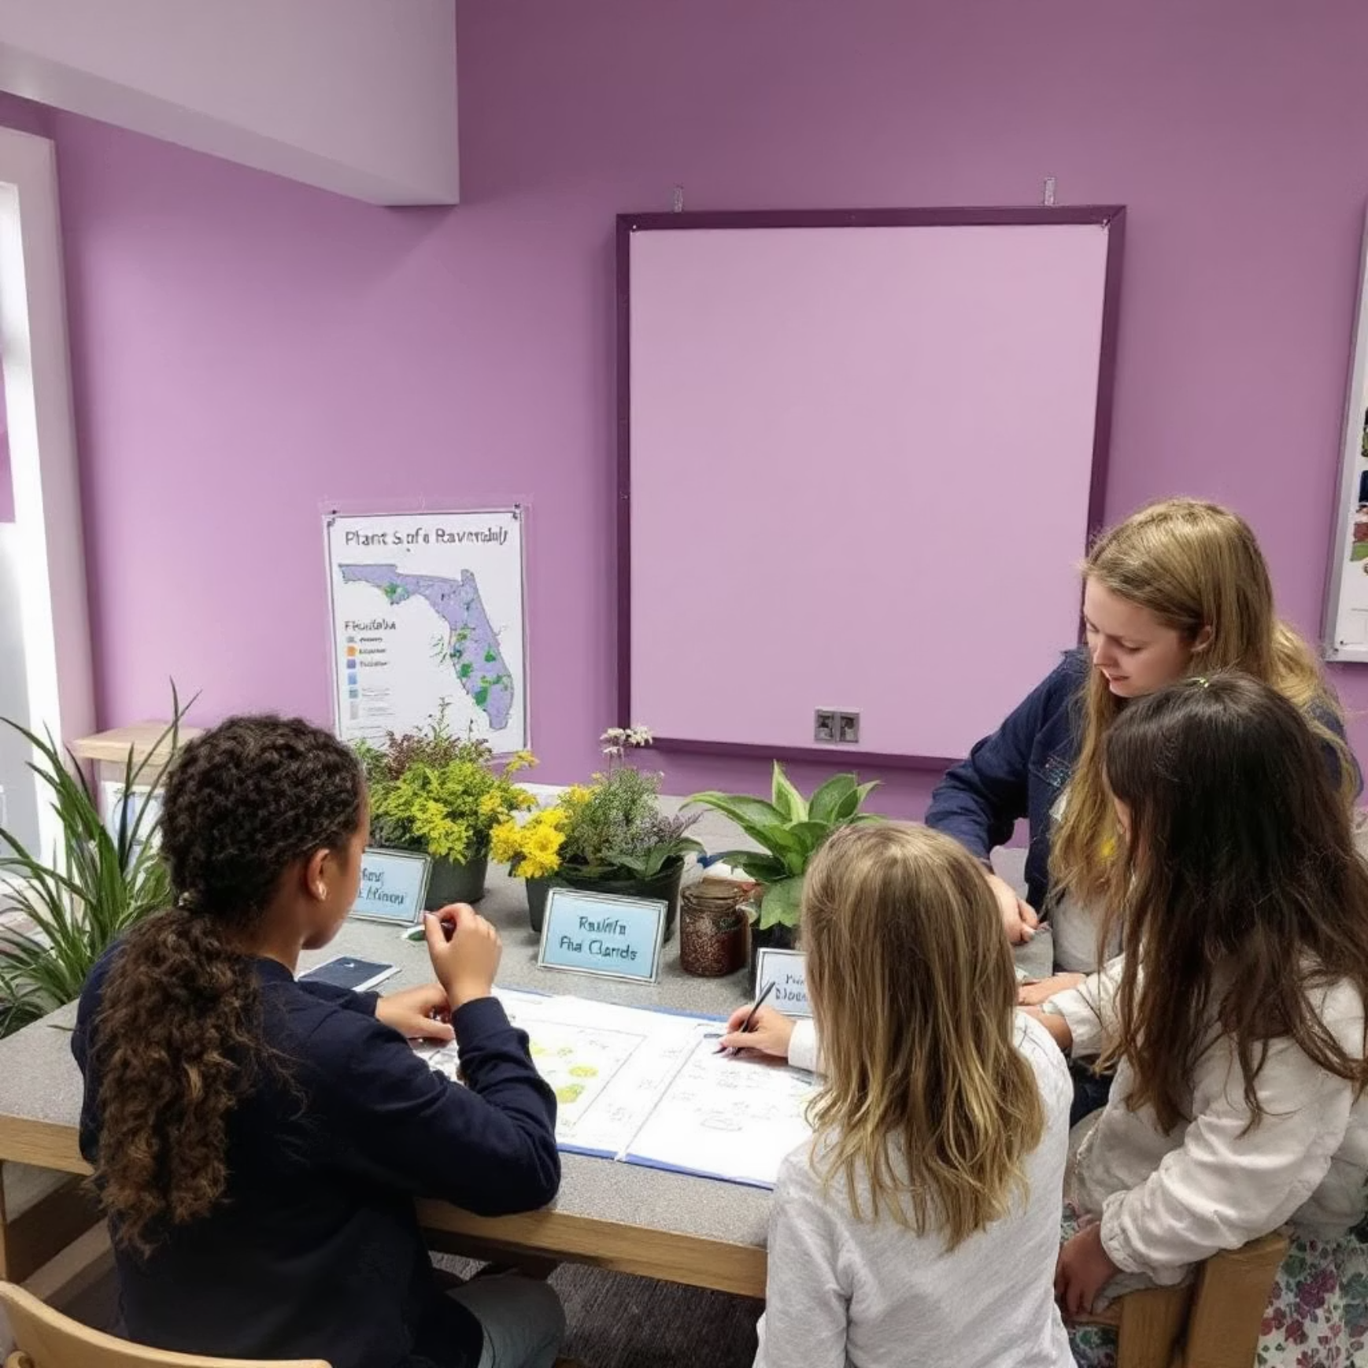
Lesson Flow
Engage (10 min)
1
Video showing sprinklers running during rainstorms vs. efficient landscapes
2
Explore (15 min)
Discussion: "What's wrong with this picture?" and "Why does it matter how we water our yards?"
Rotating stations:
Match native plants with water needs
Explain (10 min)
3
Compare efficient vs. inefficient landscapes
Mini-lesson on Florida's climate challenges, water-efficient practices, and key vocabulary
Analyze Florida rainfall patterns
4
Elaborate (15 min)
Extension Agent presentation and small group landscape design project using Florida-Friendly plants
Evaluate (10 min)
5
Exit ticket or landscape design presentations to demonstrate understanding

Slide 5



Differentiation Strategies
ESE Students
ELL Students
Gifted Students
Provide visual aids, sentence frames, extra time, and peer/adult support for group activities and design projects.
Pre-teach vocabulary with visuals, offer bilingual resources, use gestures, and allow sketching before written work.
Encourage deeper analysis of climate zones, complex landscape design with budgeting, and independent research on water-saving tech.

Slide 6
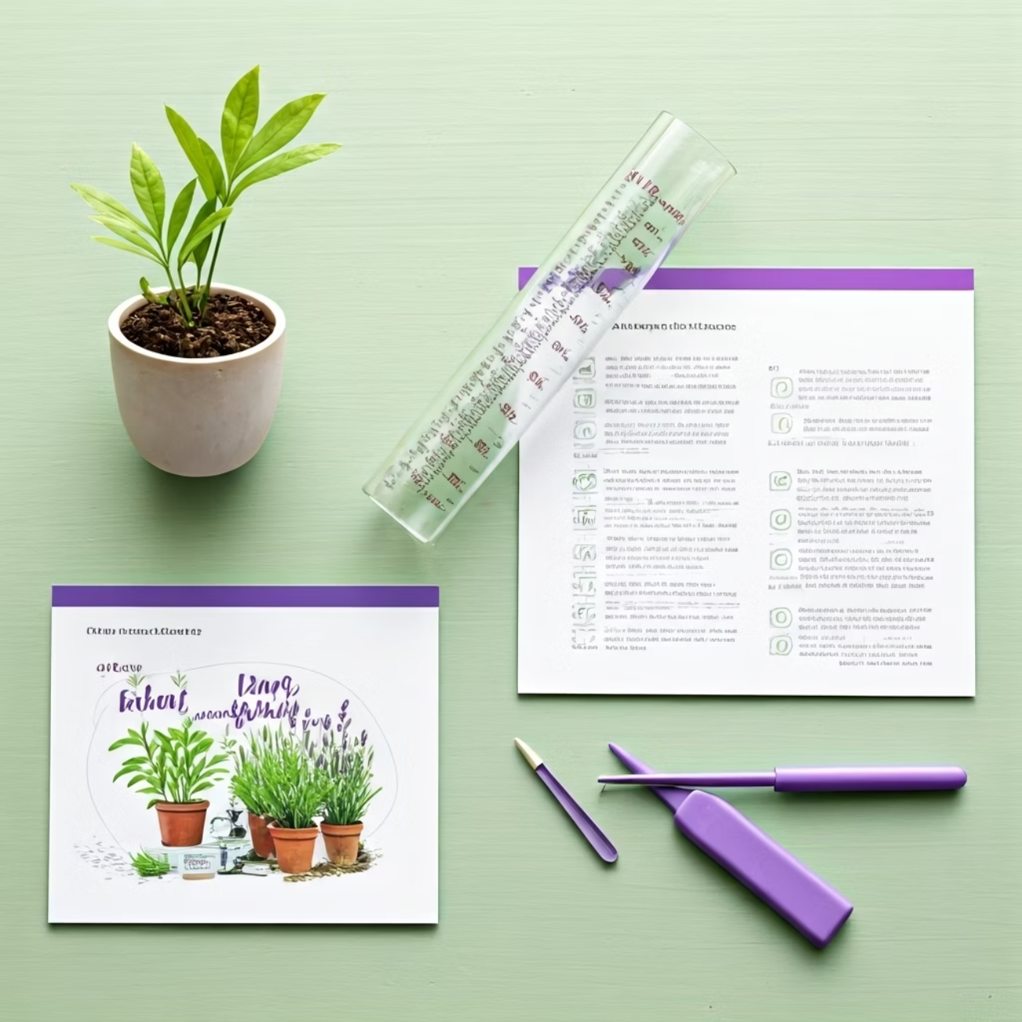
Materials & Teacher Tips
Required Materials
Florida-Friendly plant guides/cards
Climate/rainfall maps and data
Images of efficient/inefficient landscapes
Rain gauges or precipitation data
Design templates and art supplies
Teaching Tips
Contact your local Extension Office early to schedule a guest speaker
Collect real-world examples from your school grounds
Consider a follow-up outdoor activity to apply concepts
Connect to home practices with a family engagement component

