Slide 1

Gatorplan 2025
Florida Friendly Landscaping Program (FFL)
CPET
University of Florida
5E model lesson on Fertilizer application (Principle 3)
Grade level 10-12
Time needed – 150 minutes
Instructor – Sanil Nadar
PK Yonge Developmental Research School
University of Florida

Slide 2
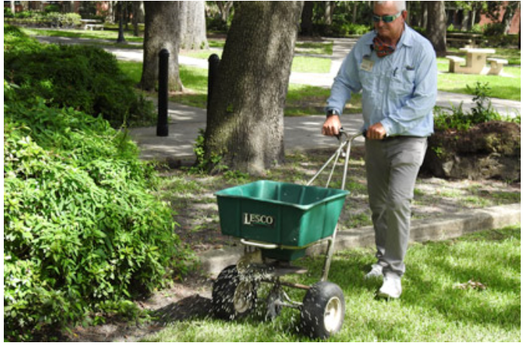
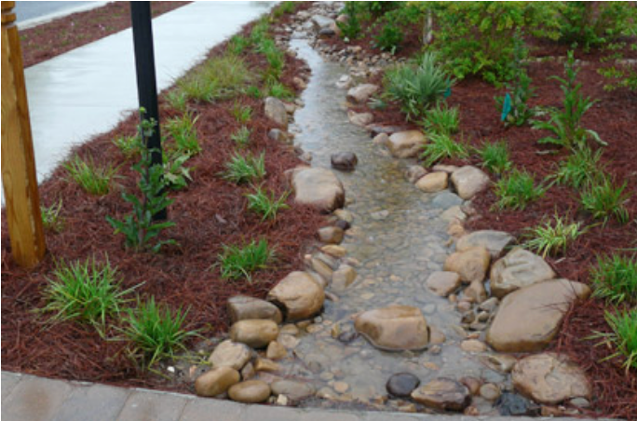
FFL Principles
Fertilize appropriately
Stormwater management
Activity - Fertilize smart
Target audience – High school
Activity - Stormwater SOS: Students on Solutions
Target audience – High school

Slide 3
Lesson design – Inquiry-Based Science Teaching (5E Model¹)
Material needed
Soil samples, Large coke bottles (1L)
Soil test kits (N, P, K, pH, Fe, Mg)
Fertilizer samples (synthetic and/or organic)
Measuring tools (spoons, scales)
Planting containers or trays
Watering cans or droppers
Runoff collection trays labeled "ponds”
Water quality test kits
Lab data sheets / Chromebooks
KWL charts, planning sheets, reflection pages etc.
Learning Objectives:
Test the soil to determine its nutrient content and identify if it requires fertilizer.
Apply different amounts of fertilizer and observe the effect on the water that runs off.
Examine the data, create graphs, and interpret the results.
Change one part of the experiment and test a new idea.
Share your results and explain how to fertilize in a way that protects the environment.
1. Duran, Lena Ballone, and Emilio Duran. "The 5E instructional model: A learning cycle approach for inquiry-based science teaching." Science Education Review 3.2 (2004): 49-58.

Slide 4
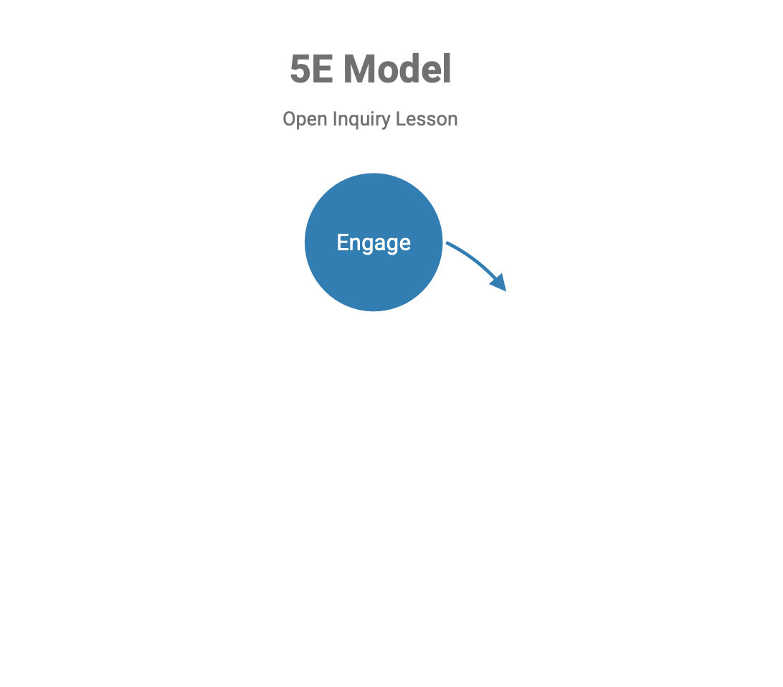
Lesson design – Inquiry-Based Science Teaching (5E Model¹)
Engage- Introduce the problem of nutrient pollution and assess baseline soil nutrient levels.
  1-minute news clip or photo of a Florida algal bloom or fish kill in the Indian River Lagoon or Tampa Bay.
  Case study summary^{2.}
Duran, Lena Ballone, and Emilio Duran. "The 5E instructional model: A learning cycle approach for inquiry-based science teaching." Science Education Review 3.2 (2004): 49-58.
Heil, Cynthia Ann, and Amanda Lorraine Muni-Morgan. "Florida’s harmful algal bloom (HAB) problem: Escalating risks to human, environmental and economic health with climate change." Frontiers in Ecology and Evolution 9 (2021): 646080.

Slide 5
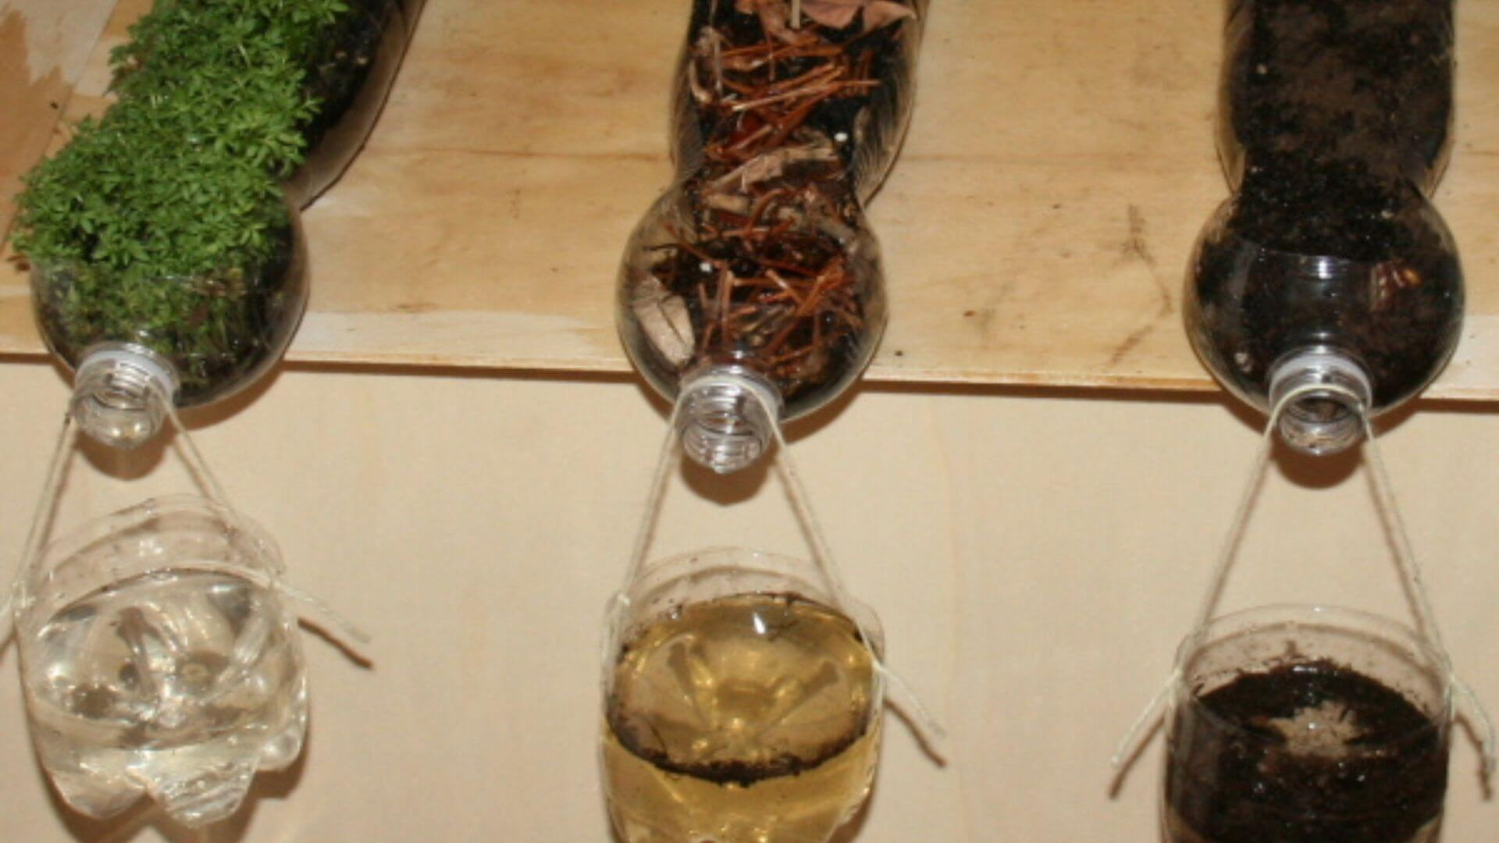
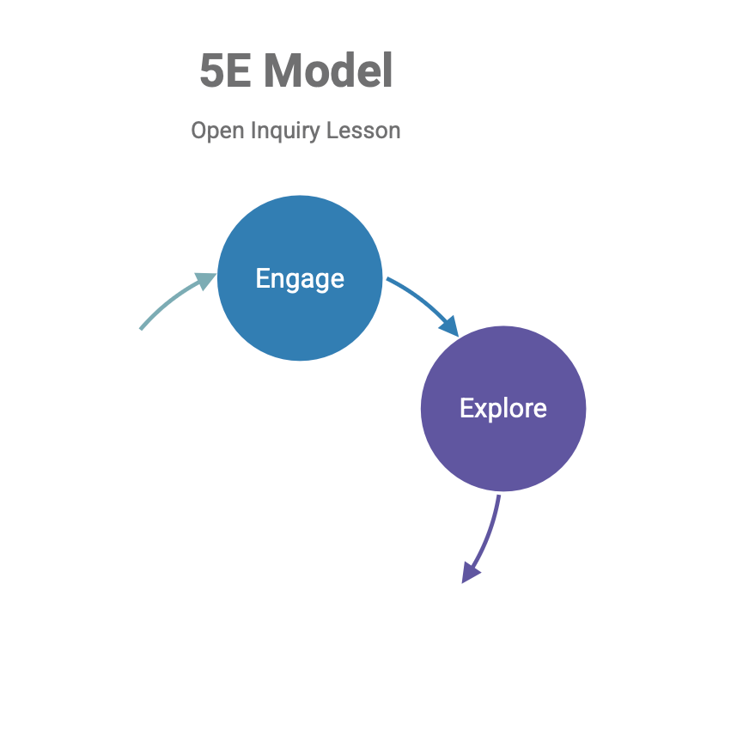
Lesson design – Inquiry-Based Science Teaching (5E Model)
Engage- Introduce the problem of nutrient pollution and assess baseline soil nutrient levels.
© Orlando Science Museum
Explore- Apply varying amounts of fertilizer and simulate runoff
  Allow students to investigate soil nutrient needs, simulate fertilization, and observe runoff effects.
  In groups, students:
    Conduct baseline soil tests (N, P, K, Fe, Mg, pH)
    Plan and apply fertilizer to model plots (Control, Appropriate, Over-fertilized)
    Simulate rain events and runoff collection
    Test runoff for nitrates, phosphates, turbidity, and conductivity

Slide 6
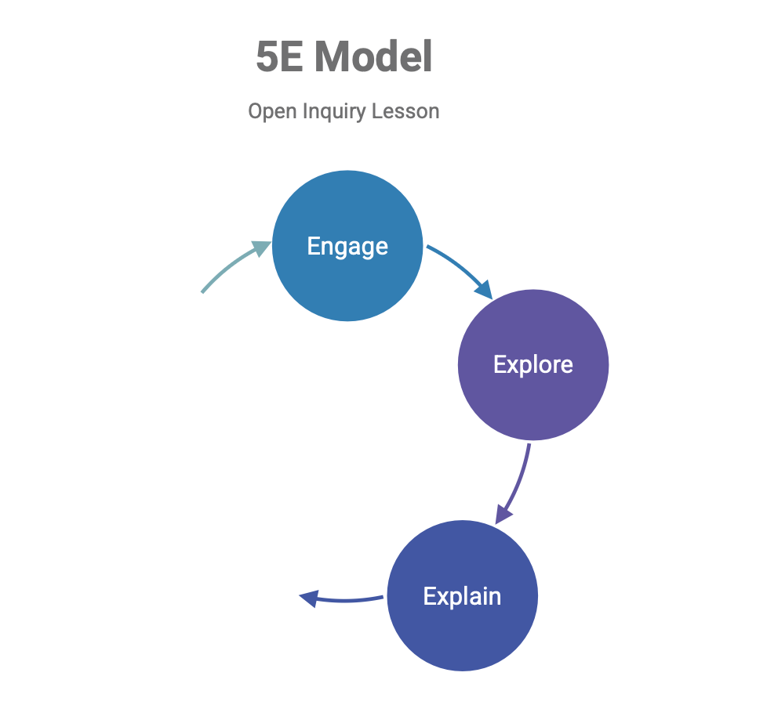
Lesson design – Inquiry-Based Science Teaching (5E Model)
Engage- Introduce the problem of nutrient pollution and assess baseline soil nutrient levels.
Explore- Apply varying amounts of fertilizer and simulate runoff
Explain- Test runoff water for indicators of eutrophication.
Student groups present findings from soil and runoff tests.
Teacher-led mini-lecture:
Explain nutrient cycles, eutrophication, and urban fertilizer runoff (Tampa Bay case study).
Discuss the Florida Friendly Landscaping™ Principle #3 and regional fertilizer ordinances.

Slide 7
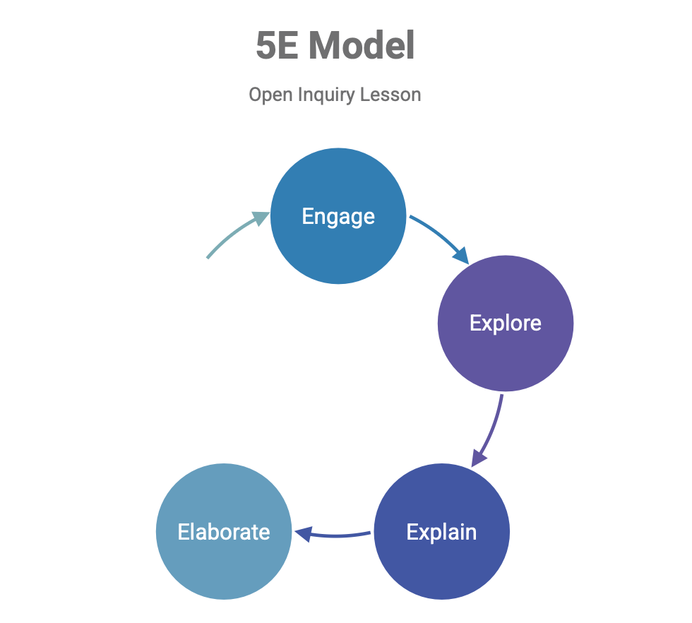
Lesson design – Inquiry-Based Science Teaching (5E Model)
Engage- Introduce the problem of nutrient pollution and assess baseline soil nutrient levels.
Explore- Apply varying amounts of fertilizer and simulate runoff
Elaborate- Deepen investigation with a new variable or hypothesis. (Open Inquiry)
  Modify variables (e.g., organic vs. synthetic fertilizer) and repeat the experiment
Explain- Test runoff water for indicators of eutrophication.

Slide 8
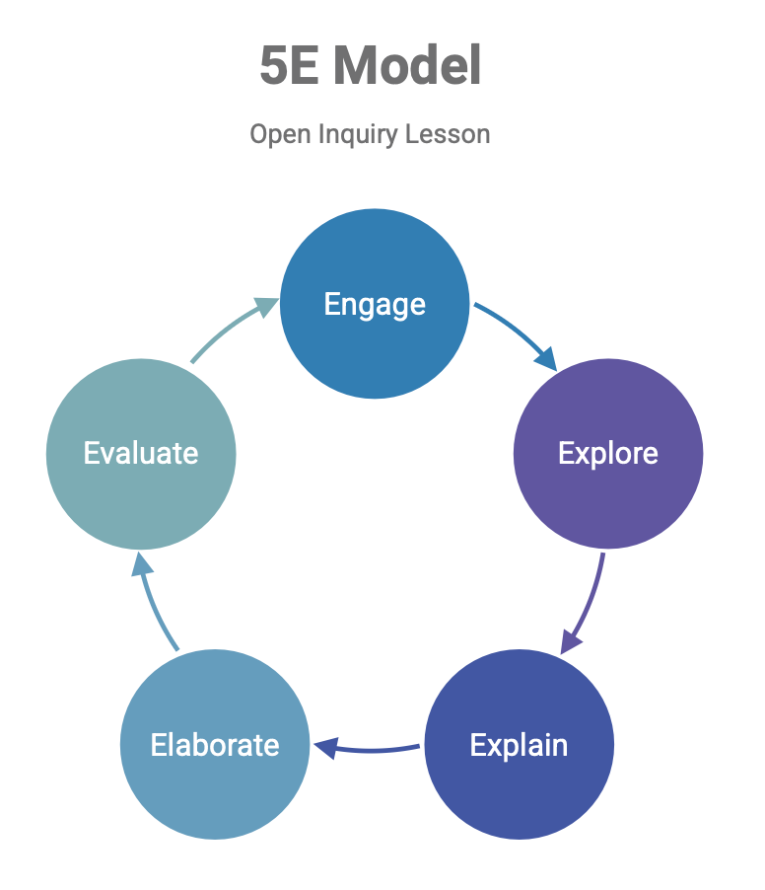
Lesson design – Inquiry-Based Science Teaching (5E Model)
Engage- Introduce the problem of nutrient pollution and assess baseline soil nutrient levels.
Evaluate - Analyze data, reflect, and demonstrate learning.
Group lab report with data tables, graphs, statistical analysis, and conclusions
Individual reflection answering:
What did you learn about fertilizer’s role in water quality?
What recommendations would you give to your community?
Short quiz: Nutrient cycles, runoff impacts, eutrophication
Explore- Apply varying amounts of fertilizer and simulate runoff
Elaborate- Deepen investigation with a new variable or hypothesis. (Open Inquiry)
Explain- Test runoff water for indicators of eutrophication.

Slide 9
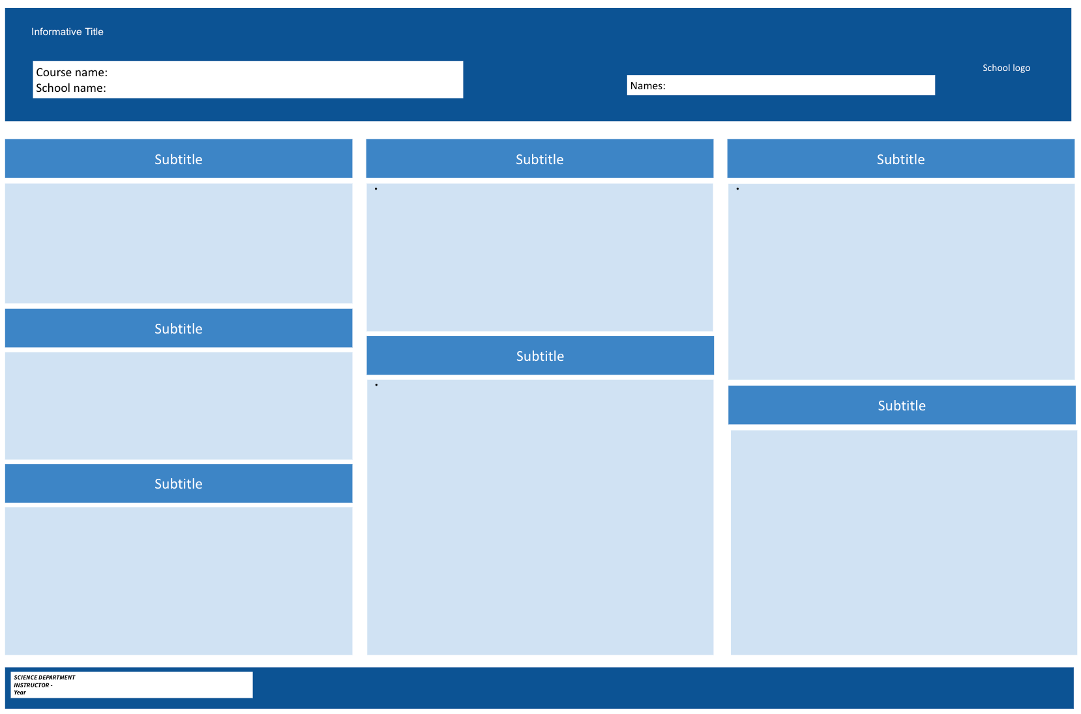
Lesson design – Inquiry-Based Science Teaching (5E Model)
Evaluate - Analyze data, reflect, and demonstrate learning.
Group lab report with data tables, graphs, statistical analysis, and conclusions
Individual reflection answering:
What did you learn about fertilizer’s role in water quality?
What recommendations would you give to your community?
Short quiz: Nutrient cycles, runoff impacts, eutrophication
Engage- Introduce the problem of nutrient pollution and assess baseline soil nutrient levels.
Explore- Apply varying amounts of fertilizer and simulate runoff
Elaborate- Deepen investigation with a new variable or hypothesis. (Open Inquiry)
Explain- Test runoff water for indicators of eutrophication.

Slide 10
Acknowledgements
CPET staff
Presenters
UF/IFAS
Florida Museum of Natural History
Department of Biology, Environmental Engineering
College of Education

